Slide 1
What processes operate at the coast?
Head | Tail
a) The coastline is… | 1. The distance over which waves can travel
b) The beach is… | 2. Churn up beach material and move it back down the beach
c) The length of fetch is… | 3. A sloping area of sand and/or shingle, found on the shore
d) The swash is… | 4. The line along the land reached by the highest tides.
e) Destructive waves… | 5. Water thrown up the beach by a wave.
Task: Match up the heads and tails in your books!

Slide 2
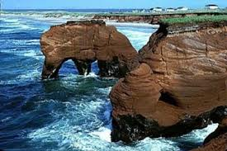
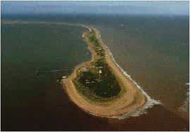
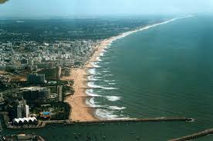
Title: What processes operate at the coast?
Lesson Objective
To Identify and analyse the three ways waves shape the coastline

Slide 3
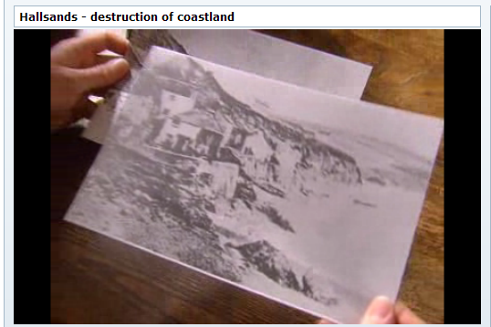
What happened at Hallsands?
Task: Summarise what happened at Hallsands. Use dates and specific evidence.
Extension: What geographical processes can you name that affected Hallsands?

Slide 4
What processes operate at the coast?
Task 1:
Move around the room and collect evidence on your worksheet of how the waves are continually shaping the coastline
Task 2:
In your book, draw an annotated diagram of Long-Shore Drift. In a group of 3, get ready to come up and demonstrate LSD!

Slide 5
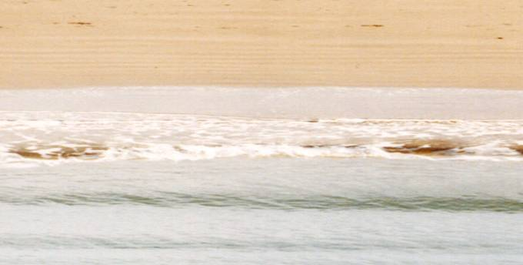
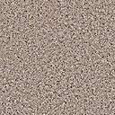
Longshore drift
Direction of longshore drift movement
Backwash is always at right angles to the beach
swash
Backwash
Direction of prevailing wind

Slide 6
Waves at Work
Task:
Create a mind-map on all the coastal processes
Erosion Types
Deposition
Extension:
What problems are caused by these processes? Come up with at least 3 and explain them
Notes:
Click the images for the video links (Erosion c.1minute/Transport c.2mins)

Slide 7
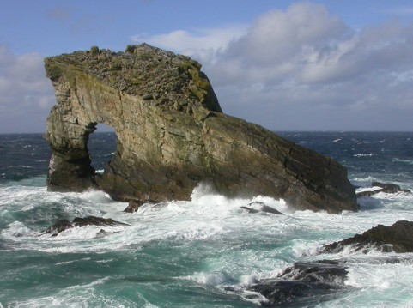
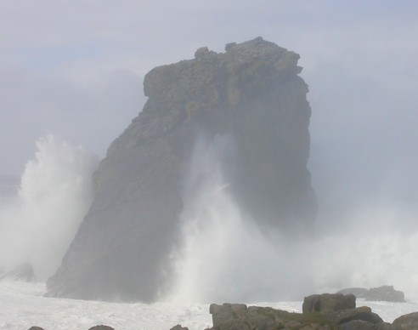
The waves FORCE water into cracks in the rocks.
This is called HYDRAULIC ACTION

Slide 8
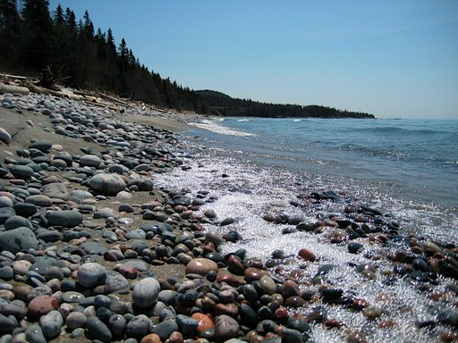
The waves knock chunks of rock together.
The rocks end up as pebbles on the beach
This is called ATTRITION

Slide 9
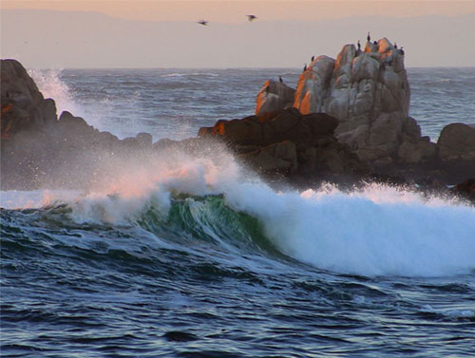
The water DISSOLVES soluble material from the rocks.
This is called SOLUTION

Slide 10
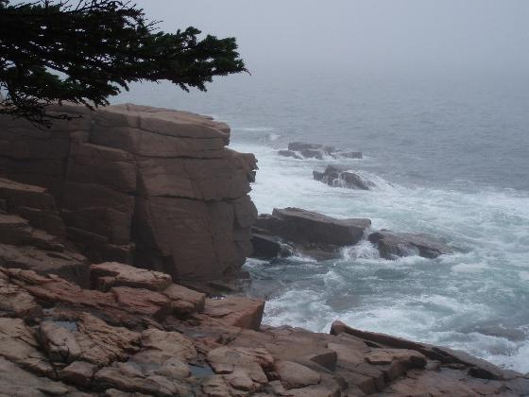
Rough seas fling pebbles against the rocks
The pebbles act like sandpaper.
This is called ABRASION

Slide 11
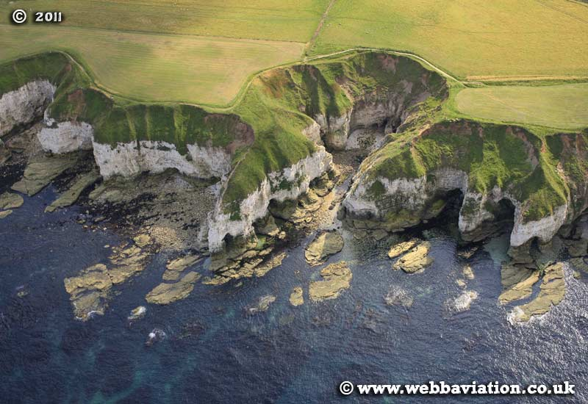
Waves force water into cracks in the rock, this pressure breaks up the rock - called hydraulic action.
Task: Write these 4 definitions in your books. Add a diagram of each.
SO REMEMBER:
Chunks of rock get knocked together and worn into smaller pieces. This is called attrition.
The waves throw sand, pebbles and large stones against the rock. They wear it away like sand paper. This is called abrasion.
The water dissolves the rock. This is called solution.

Slide 12




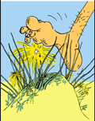
Factors which affect the speed that the coastline is eroded:
1. Rock type
Task: List these factors which affect the speed of coastal erosion. For each, write one sentence explaining how this affects erosion speed.
2. Wave type
3. If there’s a beach
4. Human activity (pollution/walking)
5. Vegetation

Slide 13

Past Exam Question:
Draw a labelled diagram to show the process of longshore drift.
(3 marks)

Slide 14
Past Exam Answer:
Diagram should show land/coast, beach, sea and direction of prevailing wind.
Particle should be shown with movement up the beach an angle and labelled swash; down the beach at right angles to the coast and labelled the backwash; and movement overall of the material along the beach labelled as direction or longshore drift.

Slide 15







Objectives: By the end of the lesson…
LEVEL 1 (Basic) C GRADE
I’ll be able to: -list the 4 types of erosion and some things that can speed it up.
LEVEL 2 (Clear)
B / A GRADE
I’ll be able to: -describe the 4 types of erosion. I’ll be able to describe factors that affect the speed of erosion.
LEVEL 3 (Detailed)
A* GRADE
I’ll be able to:
-describe in detail the types of erosion. I’ll be able to describe what affects the speed of erosion and explain WHY.
START
I know this in a lot of detail.
I know very little.
I know some stuff but will need to know more.

Slide 16
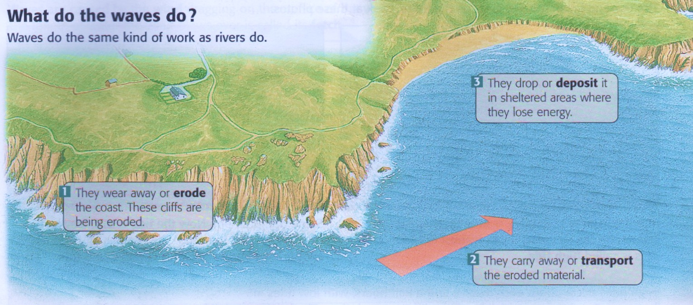
Task:
Move around the room and collect evidence of how the waves are continually shaping the coastline
Name: ______________
The Waves at Work
Process 3: _______________
Process 1: _______________
Process 2: _______________
Notes:
Student worksheet

Slide 17
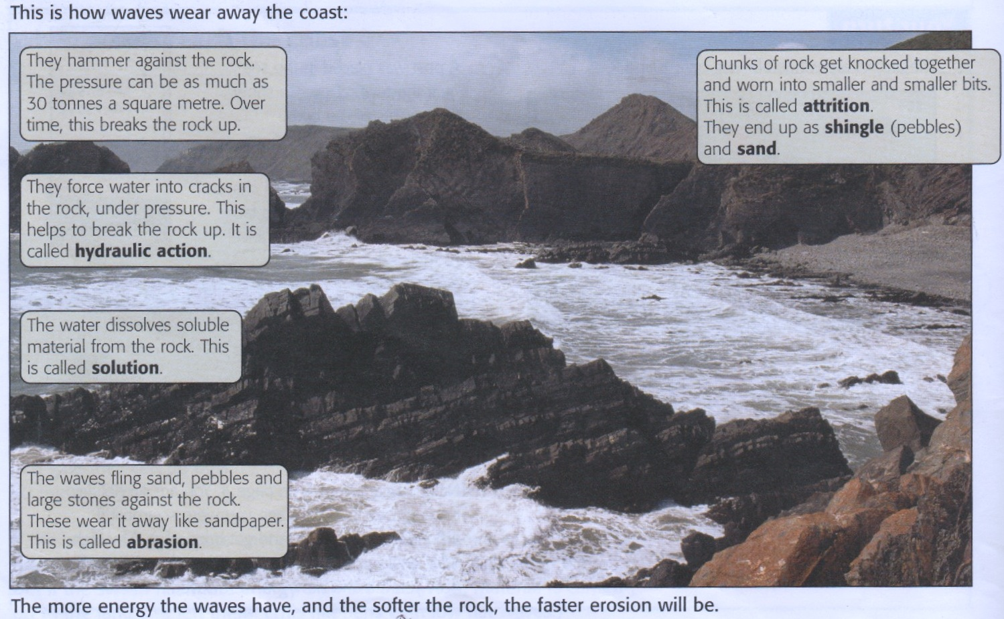
Process 1: EROSION
Notes:
Print on A4 for learning walk

Slide 18
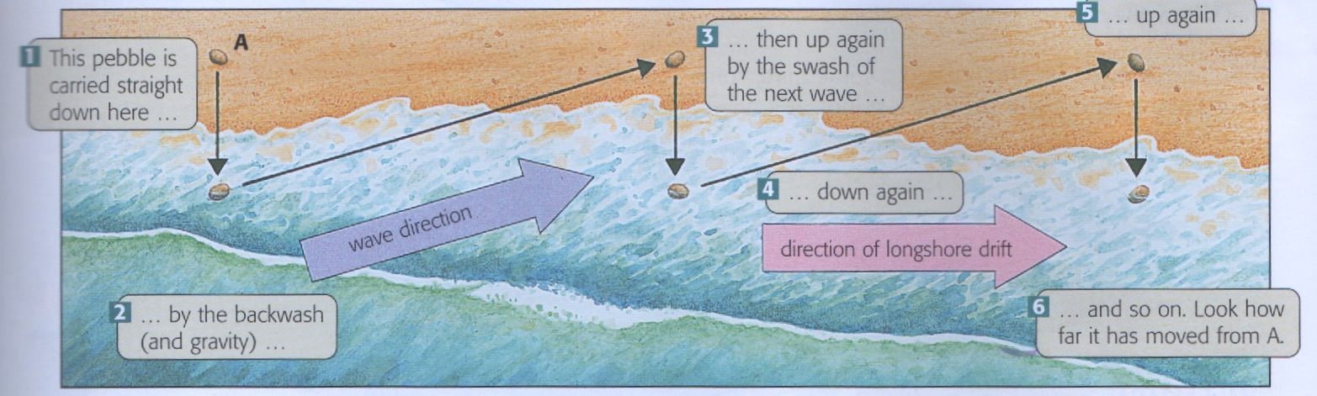
Process 2: TRANSPORTATION
The waves carry the eroded material away. Some is carried right out to sea. But a lot is carried along the coastline. This movement is called Long-shore Drift
Notes:
Print on A4 for learning walk

Slide 19
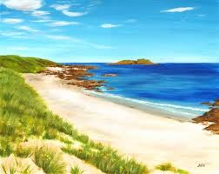
Process 3: DEPOSITION
Waves continually carry material on and off the land.
If they carry more on than off— a beach forms!
Some beaches are made of sand. Some are made of shingle or small pebbles.
Beaches grow in sheltered areas. Low flat waves carry material up the beach and leave it there.
Notes:
Print on A4 for learning walk

Slide 20
Task:
Watch the video, then match up the correct erosion type to the definition given.
Extension:
Create a small diagram to help you remember how each erosion process works
EROSION TYPE |  | HOW IT WORKS |  | DIAGRAM
 |  | the waves throw pebbles and rocks against the cliffs, wearing them away
 |  | the water itself is slightly acidic and can dissolve minerals such as calcium carbonate, which is in chalk and limestone.
 |  | the force of waves traps air in cracks …air pressure breaks off pieces of rock
 |  | the pebbles and rocks are worn away as they crash against each other
KEY WORDS
Attrition | Hydraulic Action |  | Abrasion |  | Corrosion

